Slide 1

Project Title – DAPP for LAND REGISTRY
NAME- ANUSHKA BISHNOI
COLLEGE – RAJASTHAN COLLEGE OF ENGINEERING FOR WOMEN
YEAR – 3RD YEAR ,6TH SEMESTER
COURSE - BTECH
BRANCH-COMPUTER SCIENCE AND ENGINEERING
EMAIL- anushkabishnoi099@gmail.com
AICTE Internship Student Registration ID) :
STU676f774b499a01735358283

Slide 2

PROBLEM STATEMENT
The traditional land registry system is fraught with challenges that compromise its efficiency, security, and transparency. These challenges include:
Fraud and Manipulation: Centralized databases are susceptible to unauthorized alterations, leading to fraudulent claims and disputes over land ownership.
Inefficiency: The current process involves extensive paperwork and bureaucratic procedures, resulting in prolonged processing times for property transactions.
Lack of Transparency: Limited visibility into ownership records can lead to disputes and challenges in verifying legitimate property titles.
High Transaction Costs: The involvement of intermediaries and administrative fees increases the cost of property transactions.
To address these issues, the proposed project aims to develop a decentralized application (DApp) leveraging blockchain technology to create a more secure, transparent, and efficient land registry system. By utilizing the immutable and decentralized nature of blockchain, the system will:
Ensure Data Integrity: Property records will be stored on the blockchain, making them tamper-proof and easily verifiable.
Streamline Processes: Smart contracts will automate property transfers, reducing the need for intermediaries and minimizing processing times.
Enhance Transparency: All transactions and ownership records will be publicly accessible on the blockchain, providing a clear and auditable trail of property ownership.
Reduce Costs: By eliminating intermediaries and automating processes, transaction costs will be significantly lowered.
This project seeks to revolutionize the land registration process by implementing a blockchain-based DApp that addresses the shortcomings of the traditional system, ultimately providing a more secure, transparent, and efficient method for managing property ownership.

Slide 3
Project Description: Project Overview: The traditional land registry systems are often plagued by inefficiencies, security vulnerabilities, and a lack of transparency, leading to issues such as fraudulent ownership claims, bureaucratic delays, and high transaction costs. To address these challenges, this project proposes the development of a decentralized application (DApp) utilizing blockchain technology to create a secure, transparent, and efficient land registry system. By leveraging blockchain's immutable ledger and smart contracts, the system aims to ensure tamper-proof property records, streamline ownership transfers, and reduce reliance on intermediaries, thereby enhancing trust and reducing costs in property transactions. Objectives: Enhance Security and Data Integrity: Implement a tamper-proof system where property records are securely stored on a blockchain, ensuring data integrity and reducing the risk of fraud. Increase Transparency: Provide a transparent platform where all stakeholders can access and verify property records, thereby reducing disputes and building trust among parties. Streamline Processes: Utilize smart contracts to automate property transactions, reducing the need for intermediaries and minimizing processing times. Reduce Costs: By automating processes and reducing reliance on intermediaries, transaction costs associated with property transfers can be significantly lowered. Key Features: Immutable Record-Keeping: Each property title is represented as a non-fungible token (NFT) on the blockchain, containing essential details such as GPS coordinates, ownership history, and legal documents. Smart Contract Automation: Smart contracts facilitate automatic execution of agreements when predefined conditions are met, ensuring swift and error-free property transfers. Decentralized Access: Authorized stakeholders, including government agencies, buyers, sellers, and financial institutions, can access and verify records in real-time, ensuring consistency and reducing the potential for disputes. Auditability: The system maintains a complete and transparent history of all transactions, enabling easy auditing and verification of property titles. Technical Approach: The application will be built on a permissioned blockchain platform, such as Hyperledger Fabric, which offers a modular architecture and supports pluggable consensus protocols. This setup ensures that only authorized participants can validate and record transactions, maintaining data privacy while leveraging the benefits of blockchain technology. Smart contracts will be developed to handle various processes, including title transfers, lien management, and verification procedures. Implementation Steps: Requirement Analysis: Engage with stakeholders to gather detailed requirements and understand existing workflows. System Design: Architect the blockchain network, define smart contract logic, and design the user interface for the DApp. Training and Support: Provide training sessions for users and establish a support system for ongoing assistance. Potential Challenges: Regulatory Compliance: Ensuring the system adheres to local laws and regulations governing property transactions.

Slide 4

WHO ARE THE END USERS?
A blockchain-based land registry system involves various end users, each interacting with the platform to fulfill specific roles and responsibilities:
Property Owners and Sellers: Individuals or entities who hold legal titles to properties and wish to sell or transfer ownership. They utilize the platform to upload property details, images, and related documents, ensuring that potential buyers have access to accurate and verified information. thegatewaydigital.com
Prospective Buyers: Individuals or organizations interested in purchasing property. They access the platform to view available properties, verify ownership details, and engage in transactions. The system provides them with transparent and immutable records of property histories, enhancing trust in the purchasing process.
Government Authorities and Land Administrators: Officials responsible for overseeing land transactions and maintaining property records. They use the platform to validate and record property transfers, ensuring compliance with legal and regulatory frameworks. The blockchain's immutable ledger aids in reducing disputes and streamlining administrative processes.
Financial Institutions and Mortgage Providers: Banks and lending institutions that offer financial services related to property transactions. They interact with the platform to assess property titles, verify ownership, and process loans or mortgages. The transparent records facilitate quicker decision-making and reduce the risk of fraud.
Surveyors and Land Inspectors: Professionals tasked with assessing property boundaries, conditions, and valuations. They contribute data to the platform, such as GPS coordinates and inspection reports, ensuring that all property information is accurate and up-to-date.
Legal Professionals: Lawyers and legal advisors who assist in drafting contracts, resolving disputes, and ensuring that property transactions adhere to legal requirements. They utilize the platform to access historical records, verify ownership, and facilitate the legal aspects of property transfers.
General Public and Researchers: Individuals seeking information on property records for various purposes, including research, investment analysis, or personal interest. The platform provides a transparent and accessible repository of land records, contributing to informed decision-making and public trust.
By accommodating these diverse end users, a blockchain-based land registry system aims to create a more secure, transparent, and efficient framework for managing property transactions and records.

Slide 5

Technology Used
Blockchain Platform: A decentralized ledger that records all transactions related to land ownership. Platforms like Ethereum are commonly used due to their support for smart contracts, which automate and enforce agreements without the need for intermediaries.
github.com
Smart Contracts: Self-executing contracts with terms directly written into code. In the context of land registry, smart contracts facilitate automatic ownership transfers when predefined conditions are met, reducing the risk of fraud and errors.
blockchainappfactory.com
Cryptographic Techniques: Asymmetric cryptography ensures that only authorized parties can access or modify land records. Each piece of land can be uniquely coded and linked to a smart key, enhancing security and reducing the potential for fraud.
blockchainappfactory.com
Decentralized Applications (DApps): User interfaces that interact with the blockchain network, allowing stakeholders such as property owners, buyers, government officials, and financial institutions to access and manage land records seamlessly.
github.com
Database Integration: While blockchain serves as the immutable ledger, integrating it with traditional databases can enhance data retrieval and management capabilities, providing a comprehensive solution for land record management.
modex.tech

Slide 6
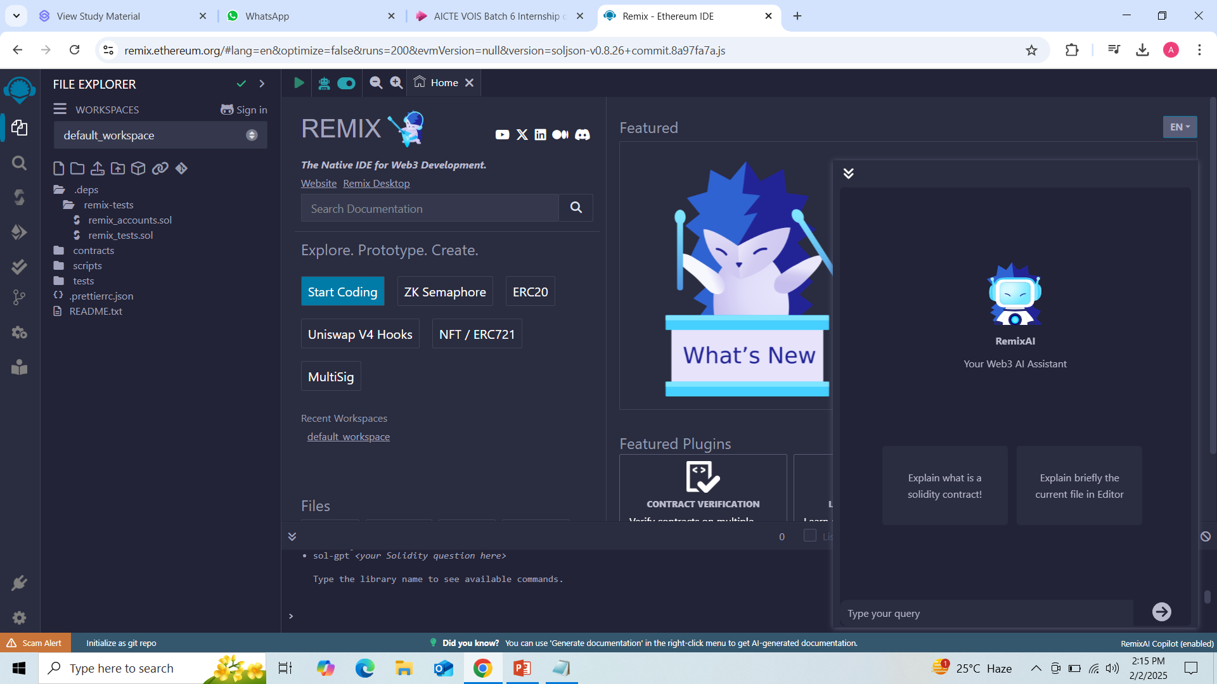
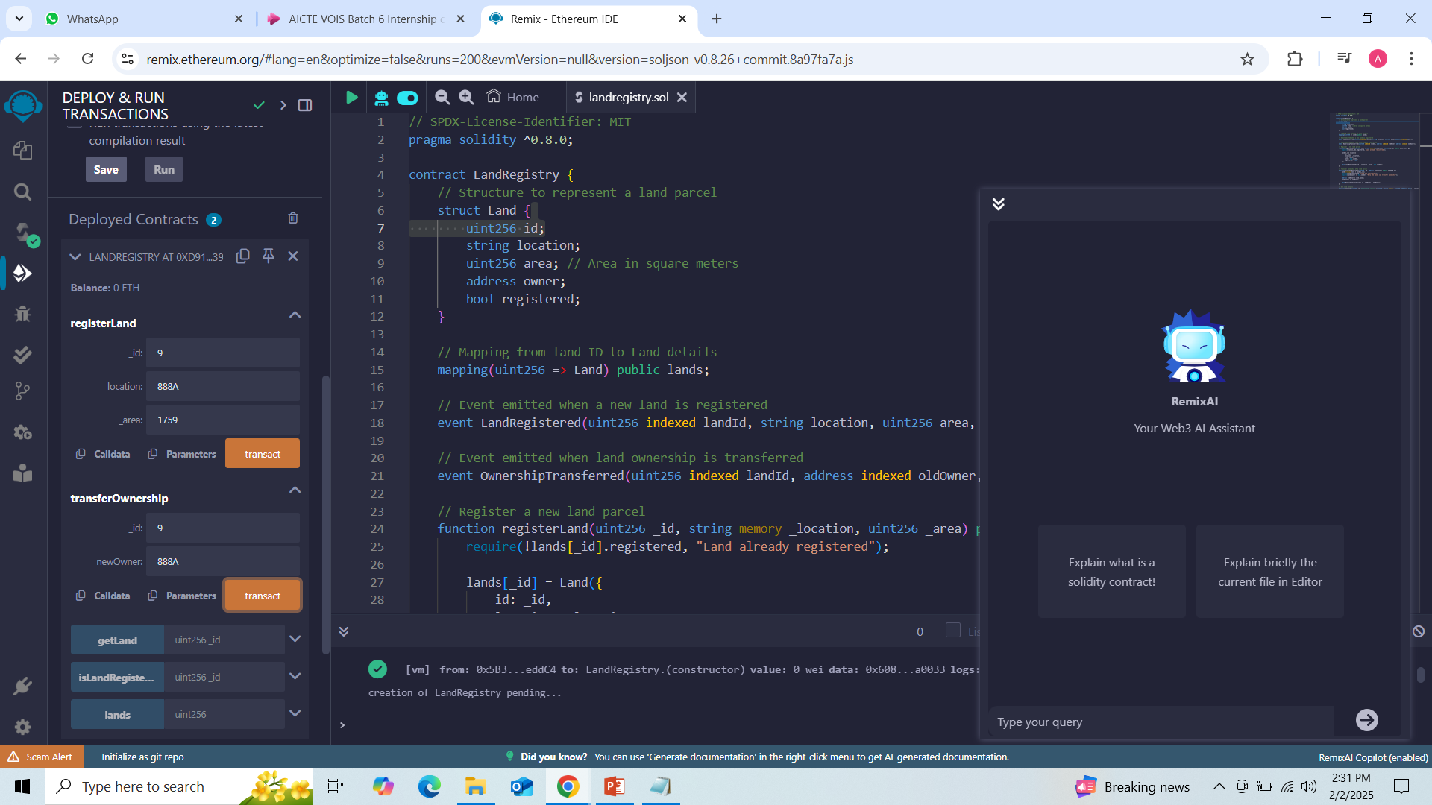
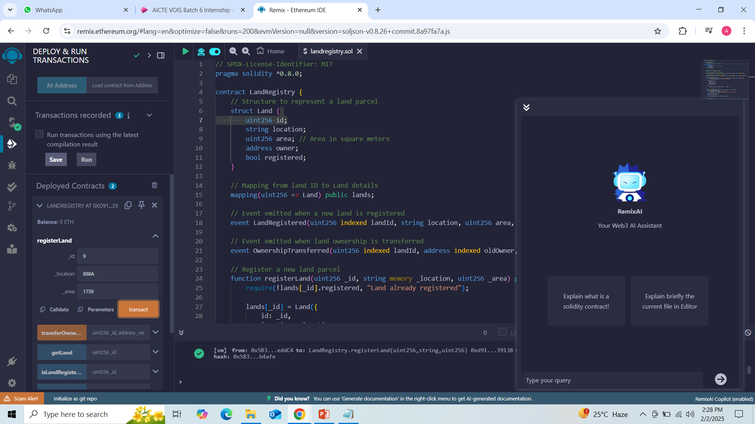
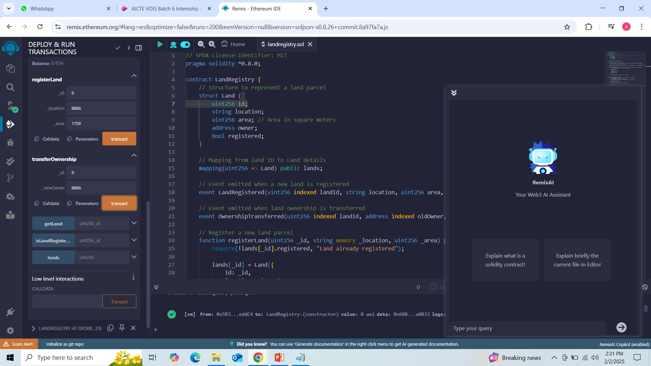
RESULTS
Screenshots of code
https://remix.ethereum.org/#lang=en&optimize=false&runs=200&evmVersion=null&version=soljson-v0.8.26+commit.8a97fa7a.js

Slide 7
Thank you
.
.

